Slide 1


Computer Networks and Network Security: Lab Assignment Three (Part 1): HTTP
Protocol and Web Server
2021.10.26

Slide 2
Assignment Requirements
Testbed for Performance Evaluation
Part 1a: Simple Client
Part 1b: Sequential and Per-thread HTTP Server
2

Slide 3
Testbed
192.168.0.120
192.168.0.130
Apache Web Server
Curl
Student1 Web Server
Student1 Client
Student2 Web Server
Student2 Client
...
...
StudentN Web Server
StudentN Client
Performance Evaluation: You need to measure the performance of using curl to access (Get Method) the web server you designed, and the performance of the client you designed to access (Get Method) the web server you designed.
3

Slide 4
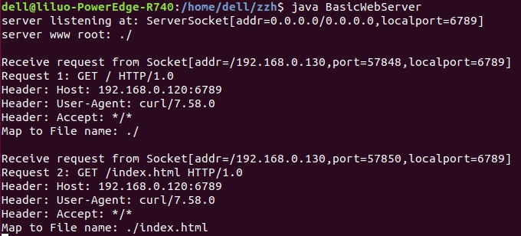
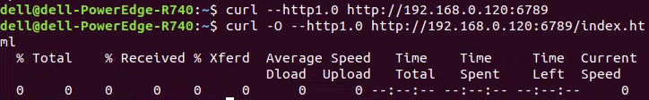
Testbed
192.168.0.120 Server
192.168.0.130
Client
It is recommended to use the last 4 digits of the student ID as the port.
4

Slide 5
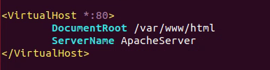
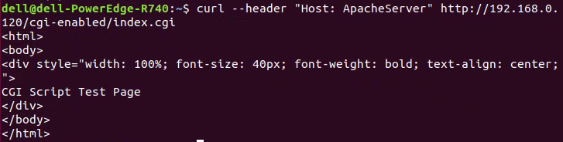
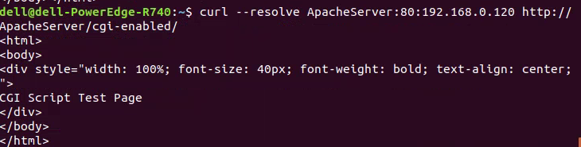
Testbed
192.168.0.120 Server
192.168.0.130
Client
Server: 192.168.0.120
VirtualHost:
Server name: ApacheServer
5

Slide 6
Connecting to the Server
Using VPN of XMU
Using ssh or other tools (Xshell) to connect to the server
192.168.0.120 --- Server
59.77.13.187:7120
UserName: your initials in lowercase
Password: the last 4 digits of your student ID
192.168.0.130 --- Client
59.77.13.187:7130
UserName: your initials in lowercase
Password: the last 4 digits of your student ID
6

Slide 7
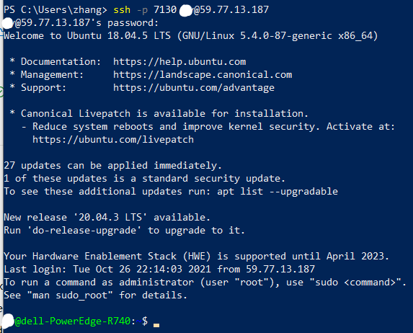
Connecting to the Server
Using VPN of XMU
Using ssh to connect to the server
Using Git and Github (Gitee) to push or pull your code between the server and your host.
7

Slide 8
Simple Client
Client
The clients stops after “time of test”.
Parameters(URL, # of threads, time of test)
Thread 1
……
Thread N
GetMethod
Statistics
GetMethod
Statistics
Get Request
Get Request
Response Message
Response Message
Print out the information of performance evaluation
Server
8

Slide 9
HTTP Server: Configuration and Get Method
Client
Get Request
httpd.conf
Response Message
HashMap
HttpRequest
GetMethod
HTTP Request Message: GET
GET /somedir/page.html HTTP/1.0
User-agent: Mozilla/4.0
If-Modified-Since: <date>
ParseHeader
Server
9

Slide 10
HTTP Server: URL Mapping
Client
Get Request
httpd.conf
Response Message
HashMap
HttpRequest
http_URL = "http:" "//" host [ ":" port ] [ abs_path ]
HTTP Request Message: GET
GET /somedir/page.html HTTP/1.0
User-agent: Mozilla/4.0
ParseURL
Server
10

Slide 11
HTTP Server: Response Message
Client
Get Request
httpd.conf
Response Message
HashMap
HttpResponse
HTTP Response Message
Last-Modified: <date>
ResponseMessage
Server
Send
11

Slide 12
HTTP Server: Caching
Client
CacheSize <cache size in KBytes>
Get Request
httpd.conf
Response Message
HashMap
HttpRequest
HttpResponse
HashMap
Checker(…)
......
HttpCache
Server
12

Slide 13
HTTP Server: CGI
Client
Get Request
httpd.conf
Response Message
HashMap
HttpRequest
HttpResponse
URL without parameters
CGIProcess
CGIProgram
ProcessBuilder
URL with parameters
Server
13

Slide 14
HTTP Server: Heatbeat Monitoring
Client
Monitor <MyCoolMonitorClassName>
Get Request
httpd.conf
Response Message
HashMap
HttpRequest
HttpResponse
status code
HealthChecker(…)
CoolMonitor
Server
14

Slide 15
Thank you!

